Slide 1
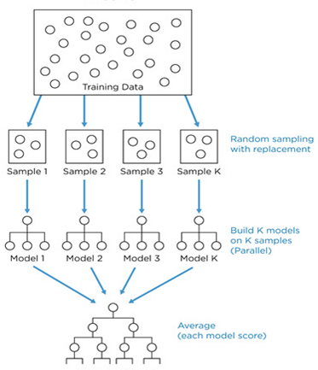
What is Random Forest
An Ensemble learning technique were result is declared by constructing multitude of decision trees.

Slide 2
How it works??
Dataset of 100 variables
Keep the number constant all through the process
Select 5 or 6 variables at each split with replacement
Construct multiple decision trees (Say 1000)
Class A (600)
Class C (300)
Class B (100)

Slide 3
How it works??
Dataset of 100 variables
Keep the number constant all through the process
Select 5 or 6 variables at each split with replacement
Construct multiple decision trees (Say 1000)
Class A (600)
Class C (300)
Class B (100)

Slide 4
Tree1
From a Dataset
N = 1000,
M = 20, m =3
Tree2
Sample S1
N = 1000,
M = 20, m =3
Sample S2
N = 1000,
M = 20, m =3
X1,X3,X7
X5,X8,X19
Apply entropy
X7
X8
S11
N = 1000
M =20
M =3
S12
N = 1000
M =20
M =3
S21
N = 1000
M =20
M =3
S22
N = 1000
M =20
M =3
X1,X4,X11
X2,X9,X10
X3,X4,X9
X6,X2,X1
Apply entropy
X11
X2
X4
X6
S111
N = 1000
M =20
M =3
S112
N = 1000
M =20
M =3
S121
N = 1000
M =20
M =3
S122
N = 1000
M =20
M =3
S211
N = 1000
M =20
M =3
S212
N = 1000
M =20
M =3
S221
N = 1000
M =20
M =3
S222
N = 1000
M =20
M =3

Slide 5
Assumptions of random forest
While building each tree in random forest, a random sample of records are selected but not all the observations in the data. This random sample varies for each individual tree
At each step of individual random tree development, best split is identified to divide the data
The aggregate output is given by taking the average of all the results given by each individual random tree.

